Slide 1
Rising Star
Yanglin, Yuchen, Chengxi
Aug 22, 2017

Slide 2
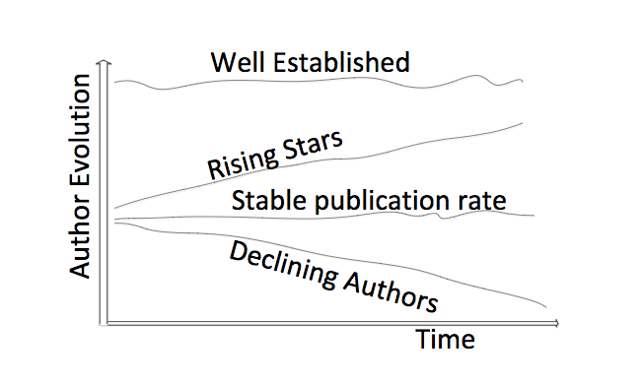
PROBLEM DEFINITION
Analyze the trends and patterns behind KOL
Predict the probability of an individual to be KOL
FIG: Four basic author’s evolution behavior over time (Tsatsaronis et al. 2011)

Slide 3
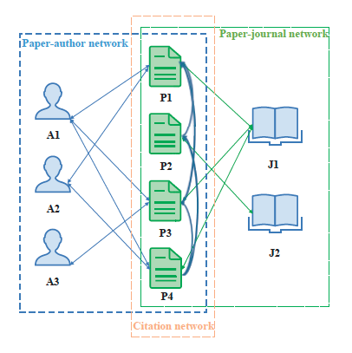
State of Art
PageRank
Supervised Learning
Clustering

Slide 4
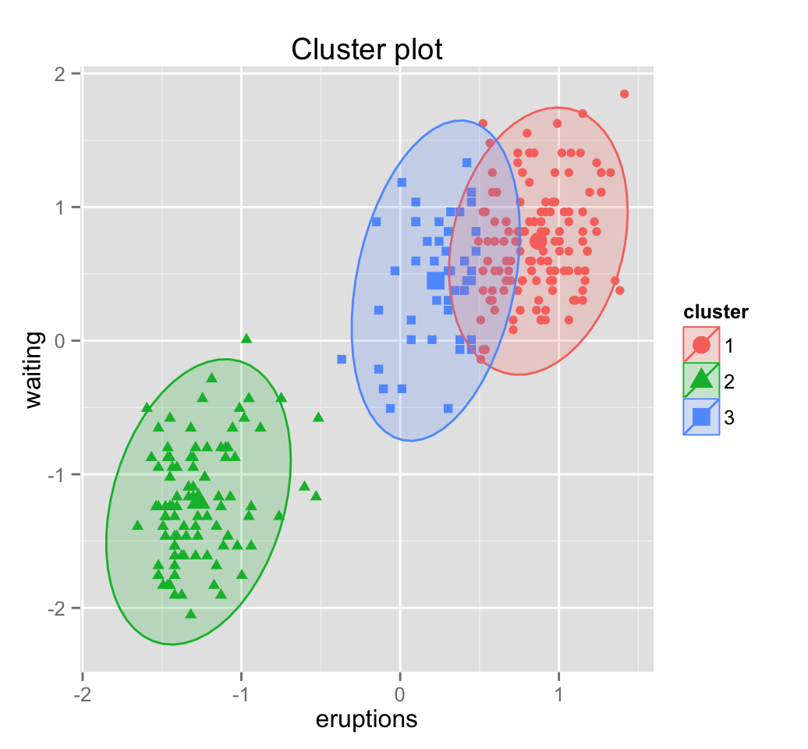
Method
Indices
Unsupervised Learning: clustering
3 steps:
Define features
Monitor the evolution of features
Use these indices to cluster authors
T
Notes:
Supervised learning is not applicable due to the absence of manually annotated data(rising stars) for this task

Slide 5
Data Preprocessing
Original variables/features
13 tables
Address
Affiliation
Events
Profile
Education
Press
Publication
Around 100 variables

Slide 6
Data Preprocessing
Derivative variables/features
HBE Universal Code
Publication Year
Article Title
Journal Name
Journal H-index
Position
Author List

Slide 7
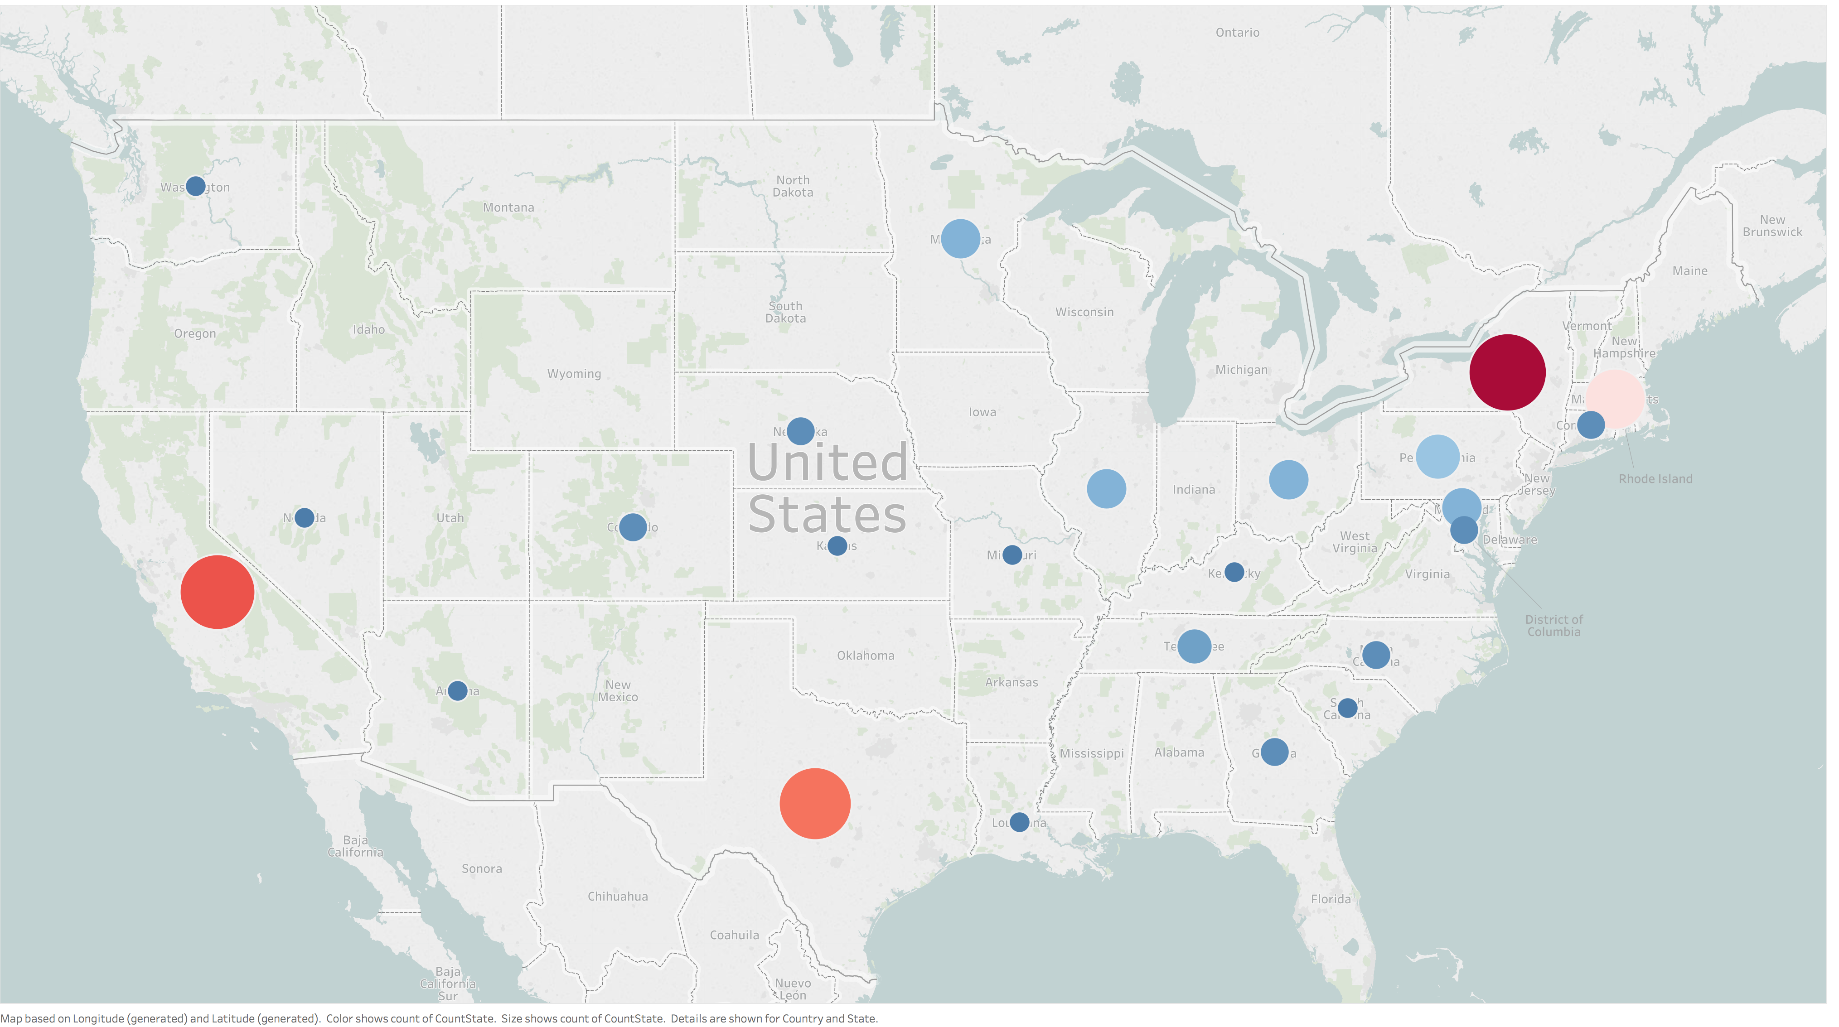
KOL's geographic distribution

Slide 8
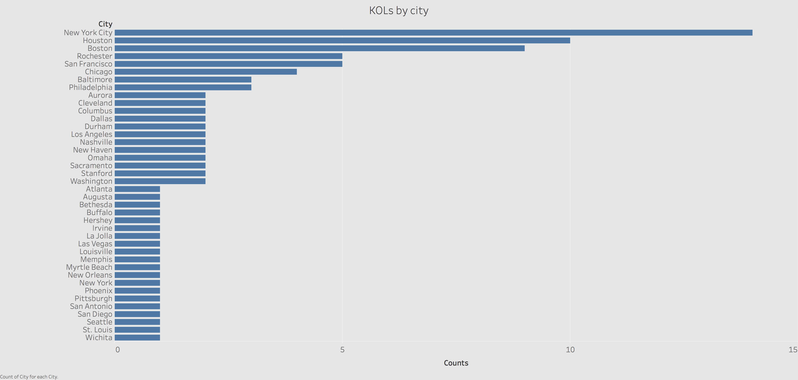

Slide 9
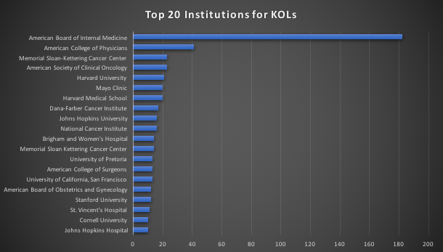
Exploratory Data Analysis

Slide 10
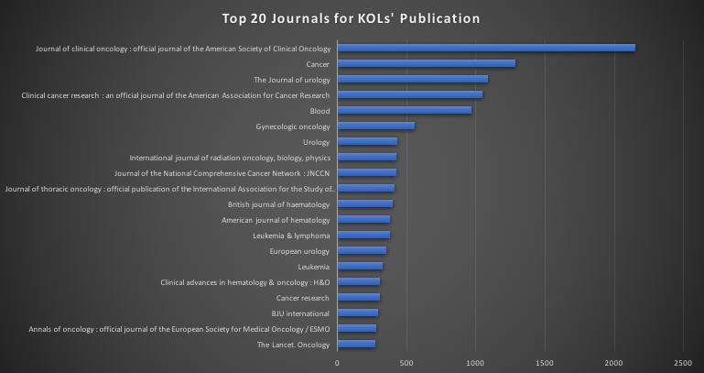
Exploratory Data Analysis

Slide 11
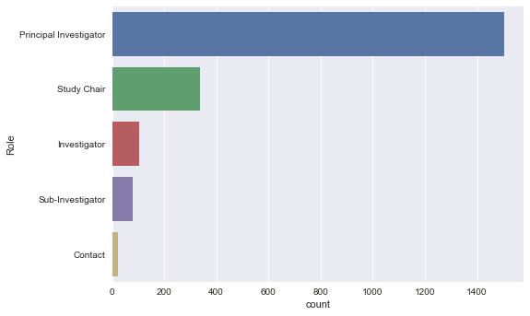
Exploratory Data Analysis

Slide 12
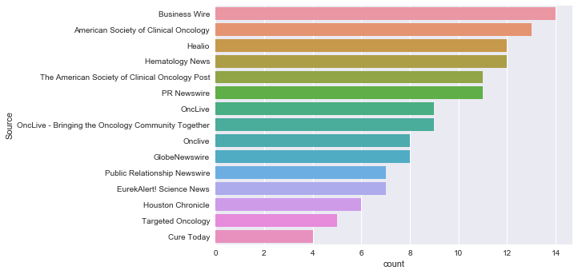
Exploratory Data Analysis

Slide 13
Extracting citation information
Why does citation information make sense
Method
Web scraping from Google Scholar
Scopus API
Pubmed
Tech issue

Slide 14
Next steps
At least 100 samples
Build model
Prediction and validation
FIG: Four basic author’s evolution behavior over time (Tsatsaronis et al. 2011)

